Slide 1
Image Classification of Radio Galaxies Using Convolutional Neural Networks (CNNs) and ResNet

Slide 2
PROJECT OBJECTIVE
Classify radio galaxy images into three classes: FR0, FRI, and FRII.

Slide 3
MOTIVATION
Understanding radio galaxy types is crucial for astronomy and space science.

Slide 4
APPROACH
Utilize Convolutional Neural Network (CNN) and ResNet to distinguish between galaxy classes using image data.

Slide 5
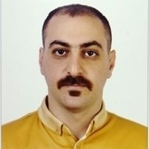


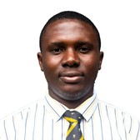
GROUP MEMBERS
Seyed Ali Rashidi
Forouzan Rezaei
Sachin Prakash
Jeremiah Daniel Effiong

Slide 6
Introduction
Radio galaxies are a special type of galaxy that produces large amounts of energy in the form of radio waves.
This energy comes from supermassive black holes at the center of these galaxies, which shoot out jets of particles moving close to the speed of light.
When these jets interact with the surrounding space, they create different shapes, or morphologies, that scientists can observe with radio telescopes.

Slide 7
Types of Radio galaxies
FR0 galaxies are compact, with no extended jets, and most of their radio emission concentrated near the core.
FRI galaxies have jets that are brightest near the galactic core and fade outward, often found in dense environments like galaxy clusters.
FRII galaxies feature long, collimated jets that end in bright hotspots, with more extended emission regions, and are found in more isolated environments.

Slide 8
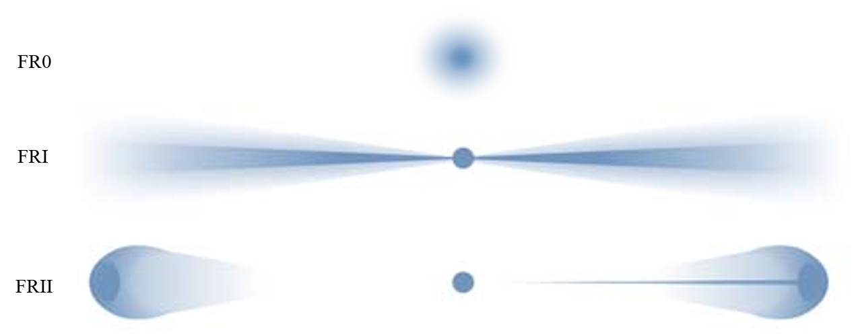

Slide 9
Roadmap
Dataset Overview
Class Imbalance and Data Augmentation
Convolutional Neural Network (CNN)
1
3
5
2
4
6
Data Loading and Preprocessing
Sobel Edge Detection and Symmetry Analysis (SSIM)
ResNet Model

Slide 10
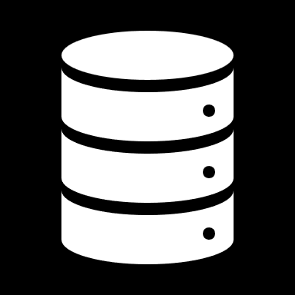
Dataset Overview

Slide 11
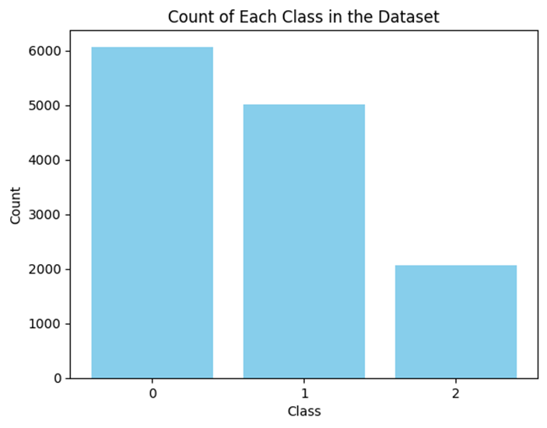
Data Distribution

Slide 12
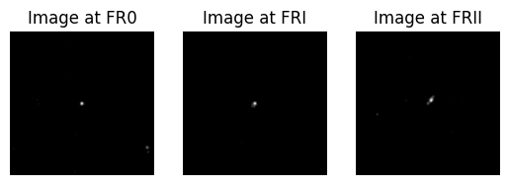
Sample Images

Slide 13
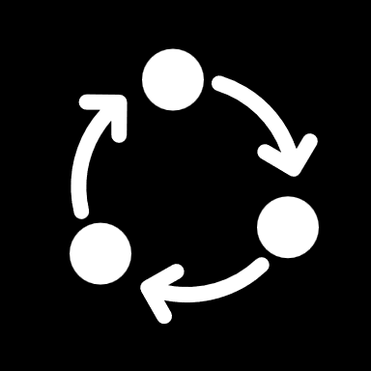
Data Pre-processing

Slide 14

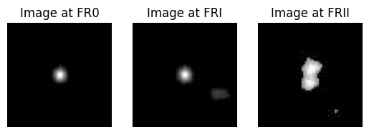
Cropping

Slide 15
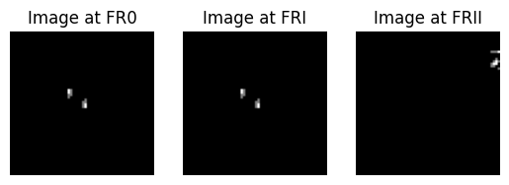
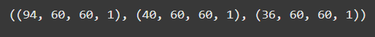
Filtering

Slide 16
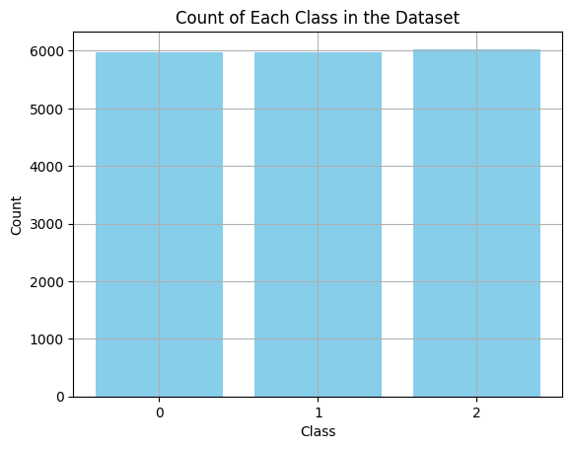
Data Augmentation

Slide 17
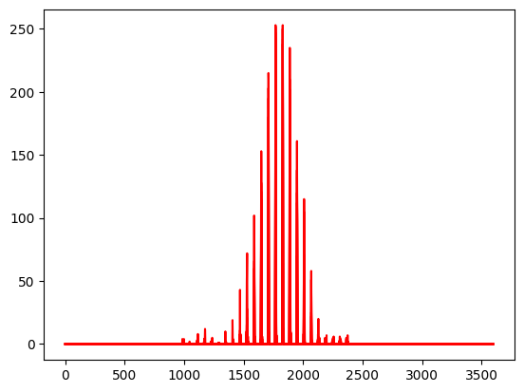
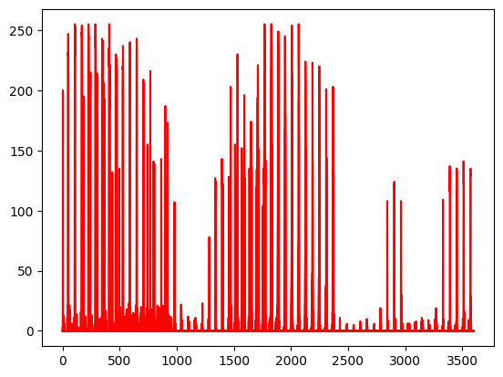
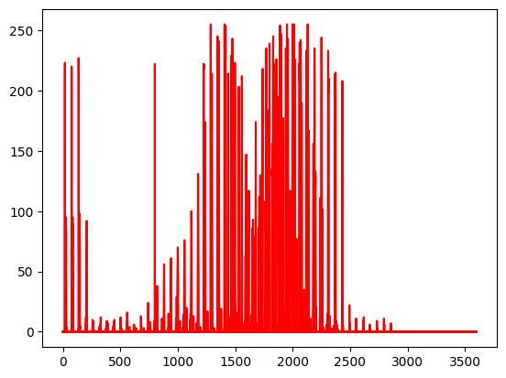
Flattening

Slide 18
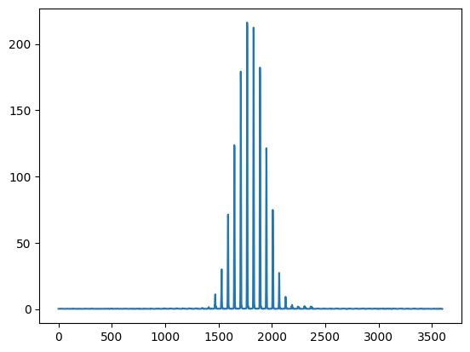
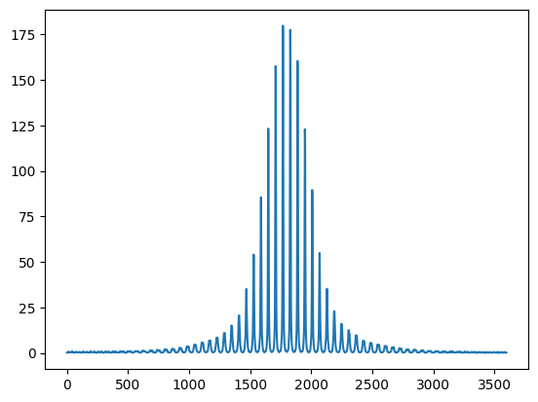
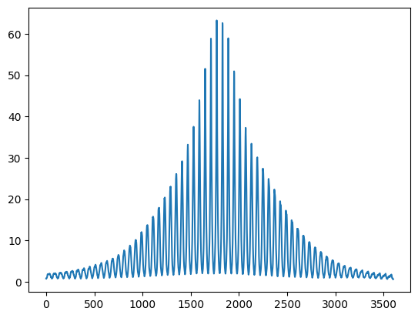
Pixels mean

Slide 19
Pixels Correlation

Slide 20
FR0

Slide 21
FRI

Slide 22
FRII

Slide 23
Sobel Edge Detection

Slide 24
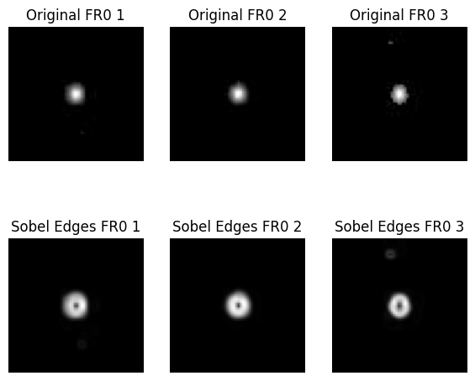

Slide 25
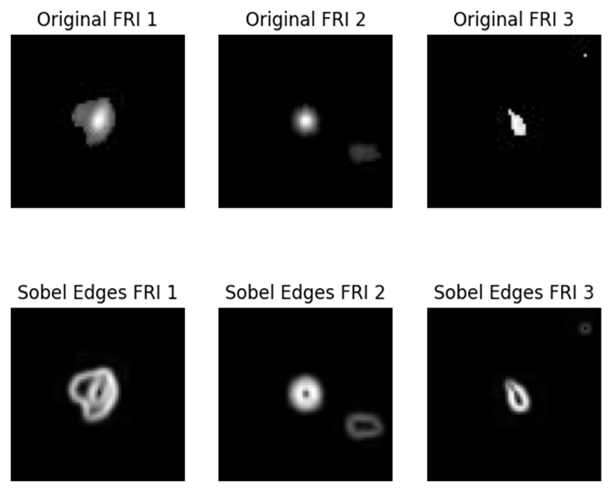

Slide 26
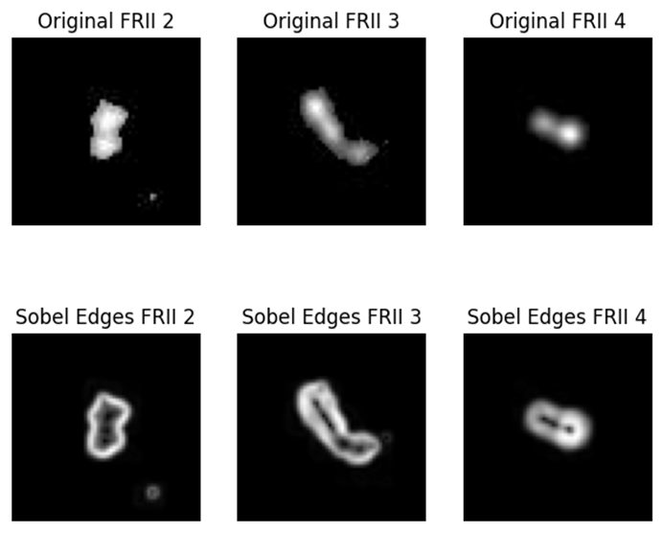

Slide 27
Symmetry Analysis

Slide 28
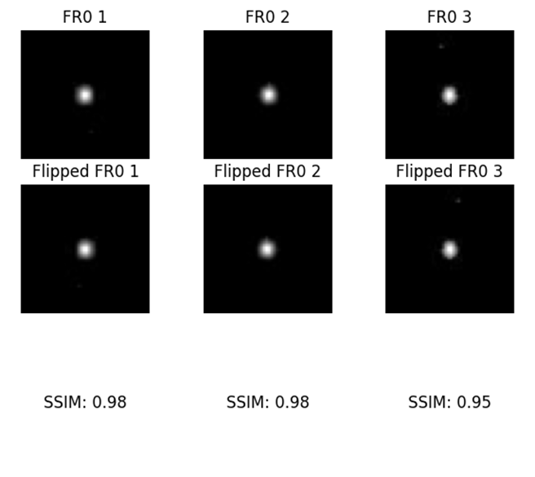

Slide 29
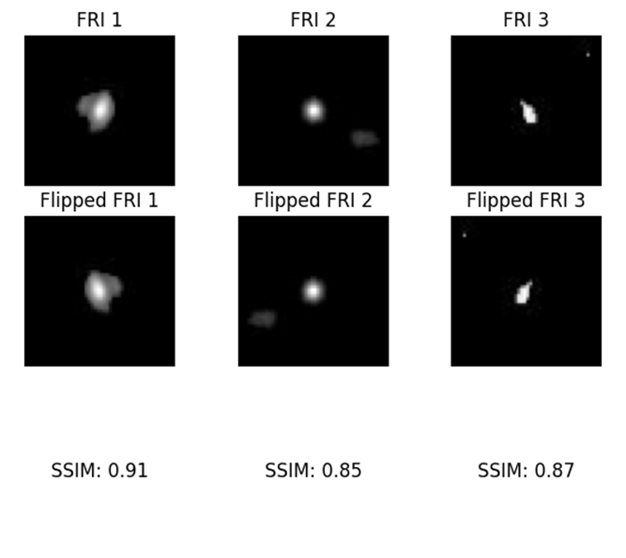

Slide 30
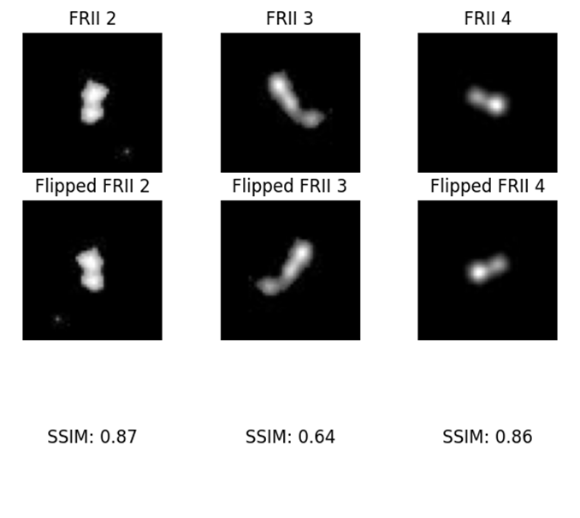

Slide 32
Preprocessing
Normalization:
Original pixel values in range [0, 255] were normalized to [0, 1] to assist in faster model convergence.
Data Splitting:
Split data into training and test sets using an 80/20 split.

Slide 33
Convolutional Neural Network Architecture
Model Type: Sequential CNN

Slide 34
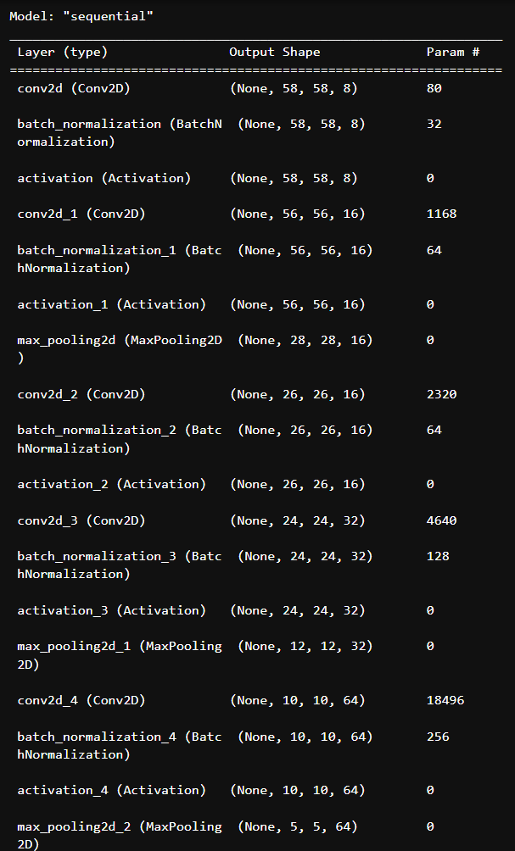

Slide 35
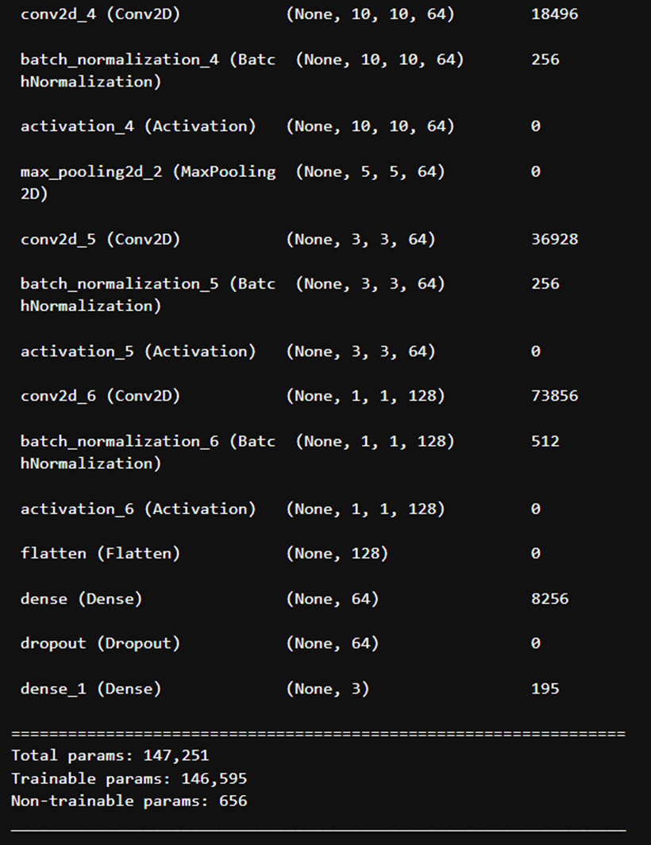
CNN Model Summary and Parameters

Slide 36
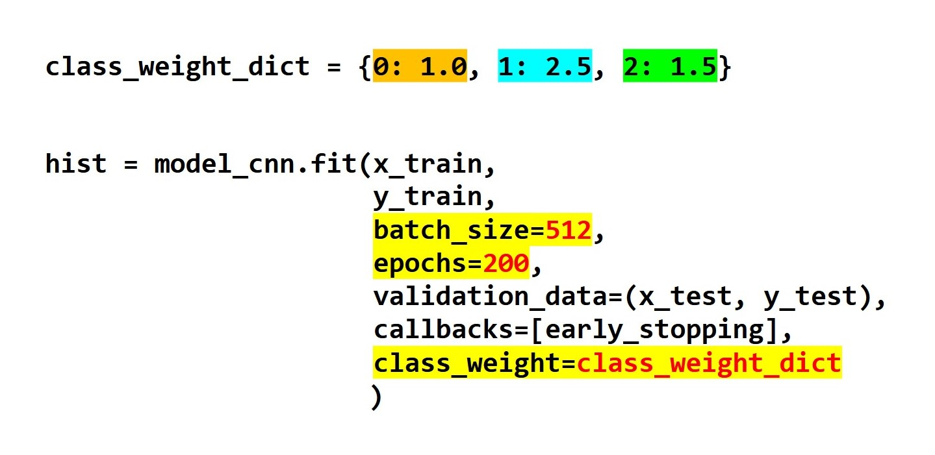
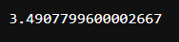
CNN Model Training

Slide 37
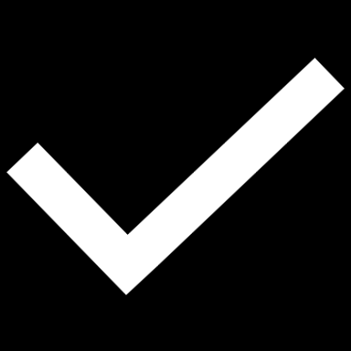
CNN Model Evaluation

Slide 38
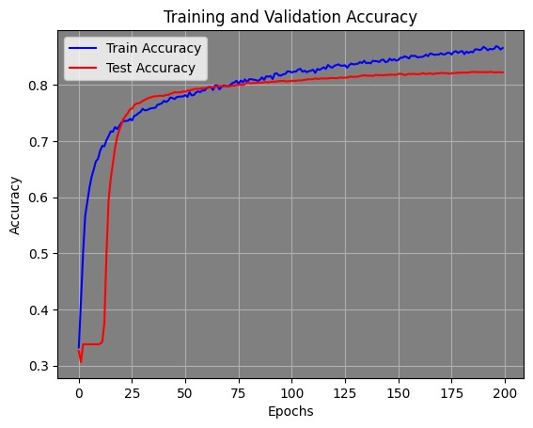
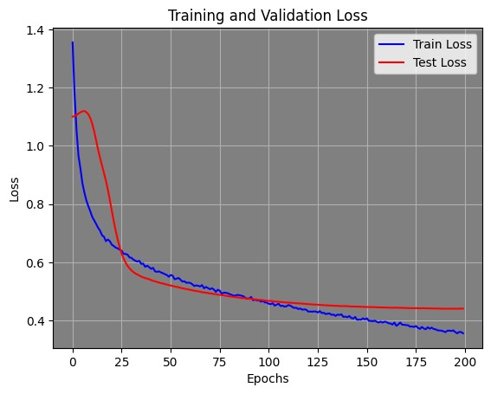
Training and Validation Plots

Slide 39
Accuracy and Loss (Before weights)

Slide 40
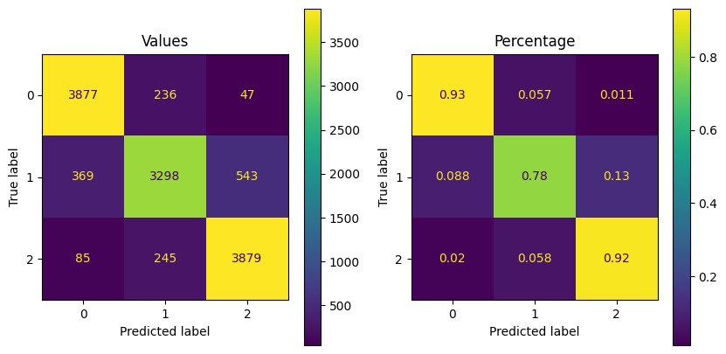
Confusion Matrix (Training Set)

Slide 41
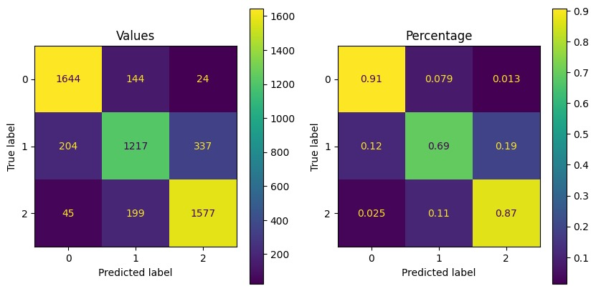
Confusion Matrix (Test Set)

Slide 42
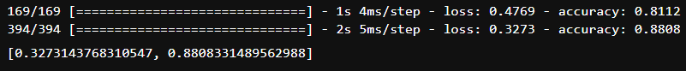
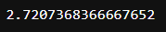
Accuracy and Loss (After weights)

Slide 43
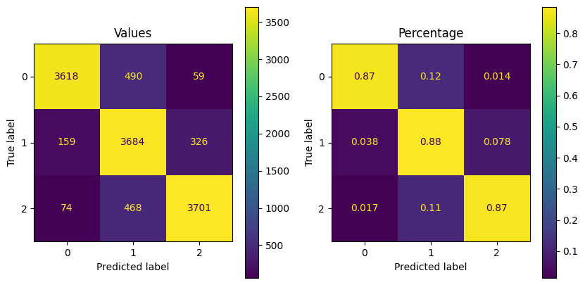
Confusion Matrix (Training Set)

Slide 44
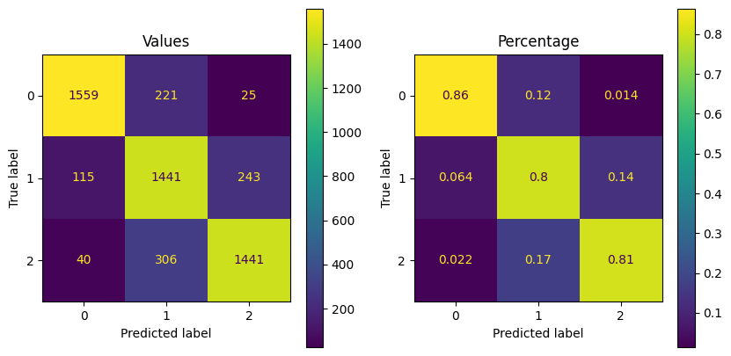
Confusion Matrix (Test Set)

Slide 45

OPTUNA
Hyperparameter optimization

Slide 46
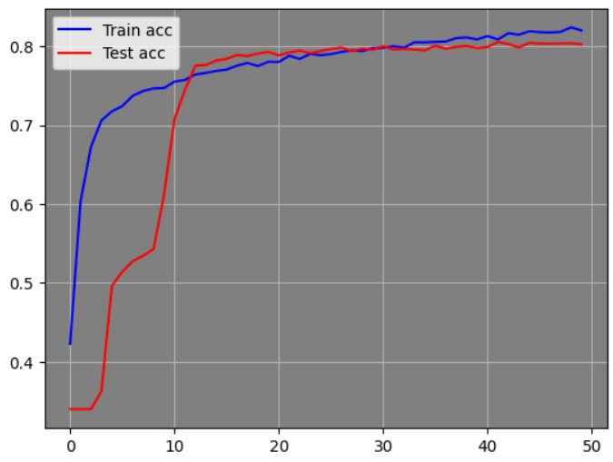
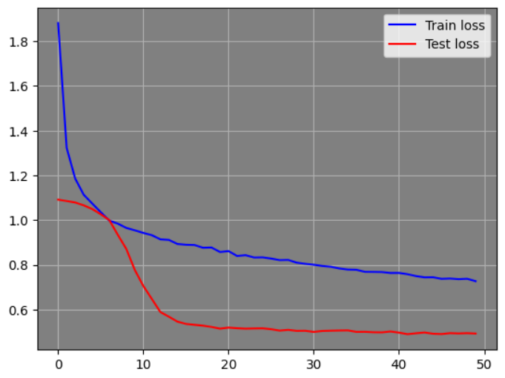
Training and Validation Plots

Slide 47
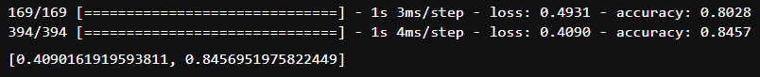
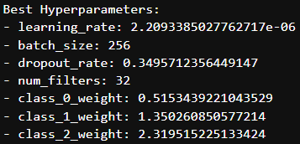
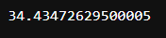
Accuracy and Loss (After Optuna)

Slide 48
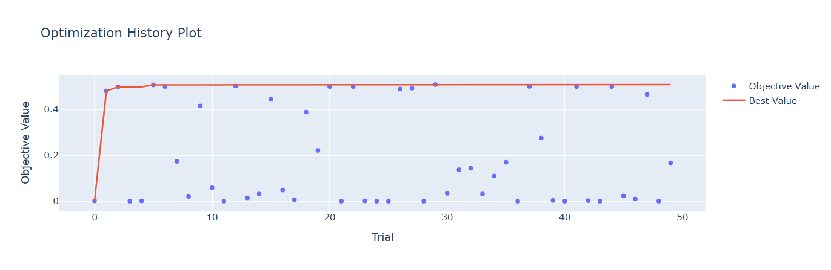
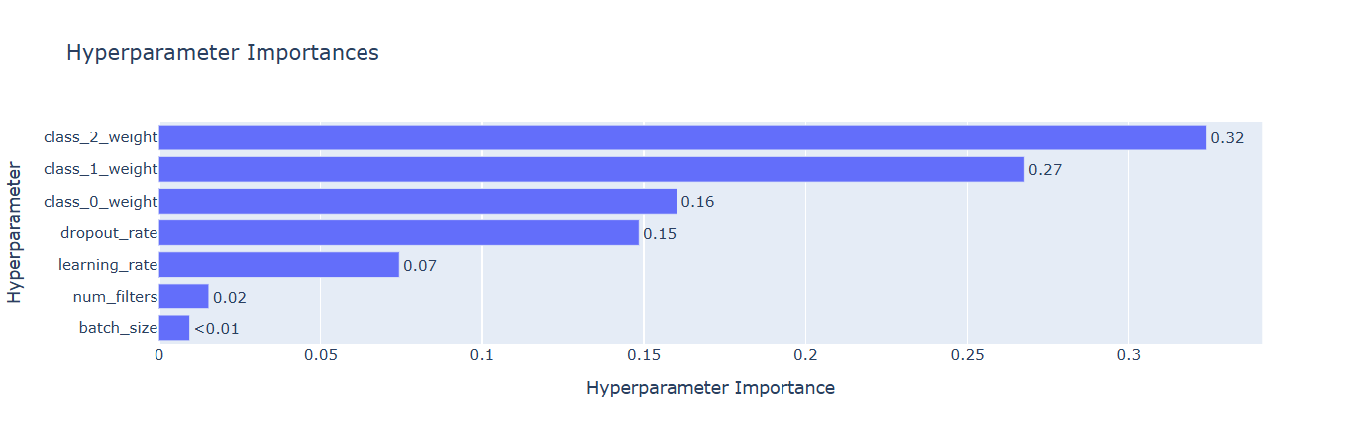

Slide 49
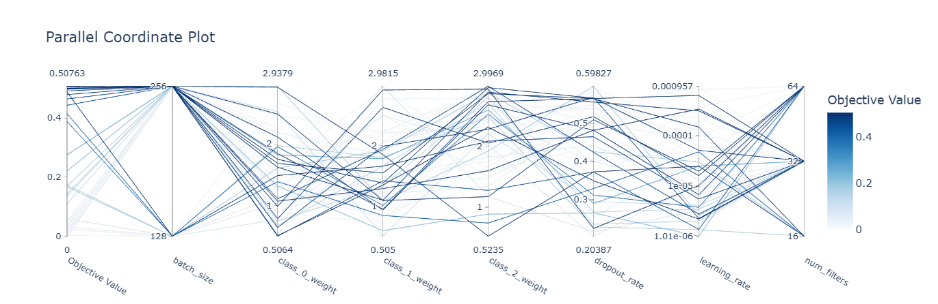

Slide 50
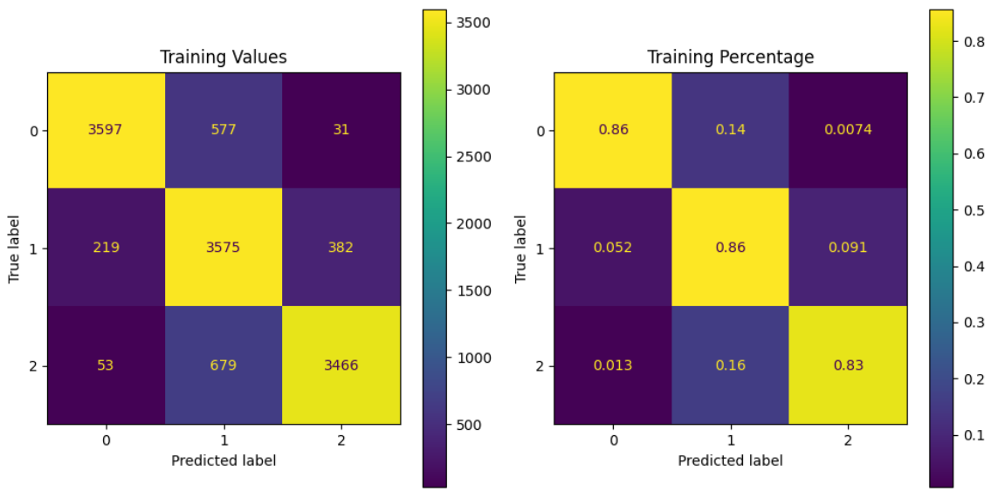
Confusion Matrix (Training Set)

Slide 51
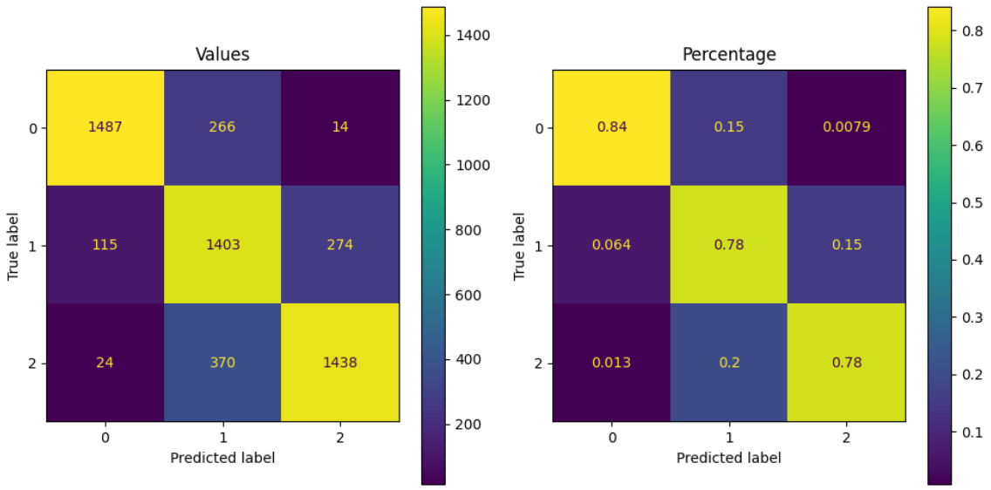
Confusion Matrix (Test Set)

Slide 52
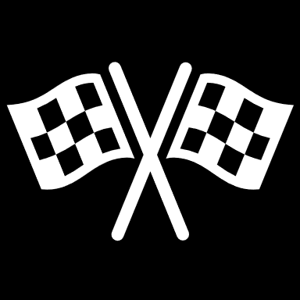
Summary and Conclusion

Slide 53
Performance Metrics
 | CNN | Optuna | ResNet
Training Accuracy | 0.8808 | 0.8457 | 0.8451
Test Accuracy | 0.8112 | 0.8028 | 0.7781
Test Loss | 0.4769 | 0.4931 | 0.5250
Training Time | 2.46 | 34.26 | 3.12

Slide 54
Thanks!

